Slide 1
Foundation of Colonial Rule in Bengal: Was it Inevitable?
Ms Farhana Afroz
Senior Assistant Professor, Dept. of Social Science
Email: farhana@aiub.edu
AIUB

Slide 2
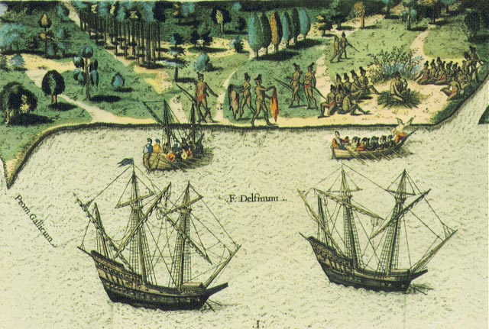
The causes of European exploration and colonization

Slide 3
3 Gs
Gold
Glory
God

Slide 4
Gold
In the 1400s, European countries were competing with each other for Natural Resources
They competed for natural resources such as gold, silk, and spices
Spices were especially valuable
Many of these things could be found in India.
Traders had to travel great distances over land to get these natural resources.

Slide 5
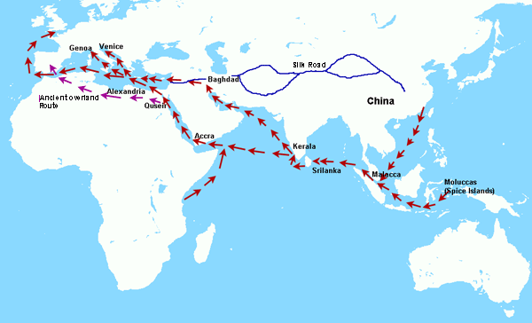
Transporting goods across these great distances was costly. Everyone along the way had to be paid and wanted to earn a profit. By the time the spices and goods reached Europe, they had to be sold at extremely high prices.

Slide 6
Gold
European Merchants knew that if they would trade directly with people in Asia, they could make enormous profits.
In the 1400s, Europeans began searching for a sea route to Asia.

Slide 7
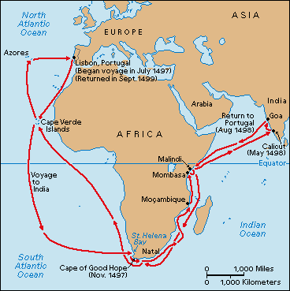

Slide 8
God
Some Europeans believed it was their duty to spread the Christian faith throughout the world.
They felt that they could convert the Native people they met in their journeys into Christians.
“Cross and flag followed each ether”
Missionaries worked for colonization process

Slide 9
Glory
As Europeans began exploring the world, they began settling Colonies.
Colonizing new areas added to a country’s territory (more natural resources, more wealth)
Colonizing also opened new markets
European countries could sell things to the people in these areas and make even more money

Slide 10
Glory
The more colonies a country had, the more wealth it had
More colonies meant more prestige or Glory
Countries began competing with one another for colonies
“Social Darwinism”

Slide 11
Motives for British Colonization
Economic Development
The TRANSITION from an agriculturally-based feudal economy to a diversified (agriculture, industry, commerce) capitalist economy created opportunities for many, but it also created economic hardship.

Slide 12
As a MONEY-BASED ECONOMY became more important, the feudal structure started to break down.
Lords, eager to increase their resources, allowed their vassals to pay fees in lieu of performing military services.
Peasants were allowed to buy their freedom and engage in independent enterprises.
The importance of agriculture declined.

Slide 13
Cloth Making
WOOL became an important industry and one of England’s most valuable exports. In addition to sheep-raising, many entrepreneurs went into the cloth making business. This industry created jobs for many peasants, but it was highly competitive and entrepreneurs who were forced out of business left large numbers of unemployed workers.

Slide 14
Foreign Commerce
The wool industry stimulated FOREIGN COMMERCE.
Entrepreneurs began to carry exports in English-owned ships.
However, foreign trade was an extremely risky business and many lost their fortunes attempting to enter the field.

Slide 15
Opportunities in ‘New World’
Many Englishmen were motivated to seek greater OPPORTUNITIES in the New World:
Second sons of noblemen (excluded from an inheritance by the law of primogeniture) sought to make their fortunes in the New World.
Members of the middle class (merchants, shopkeepers, doctors, lawyers) hoped there would be less competition in the New World.
Peasants thrown off the land or left unemployed by the wool industry sought a way to make a living in the New World.

Slide 16
Industrial Revolution: opportunities and challenges
Hobson-Lenin theory:
Surplus capital
Surplus commodities
Crisis of Raw materials

Slide 17
Economic
Industrialization
Raw materials needed for European industries
Oil in the Middle East
Rubber in Africa
Textiles in India
European Capitalism
Higher returns for investments
Less developed areas gave higher dividends
To gain access to markets

Slide 18
Political
Maintain the balance of power
To control strategic areas like sea lanes, access to markets
Status symbols
Germany takes colonies to be like other European powers
Cultural and Religious
Belief in cultural or racial “superiority”
Desire to spread Christianity to “heathens”
To spread “civilization”

Slide 19
Great powers interested in colonialism
Britain
France
Portugal
Spain
Dutch
Belgium
After 1871, Germany and Italy

Slide 20
Britain
Largest colonial empire
“Sun never sets on the British Empire”
Colonies established to protect trading interests in Africa and Asia
Two kinds of colonies
“White” Colonies (Canada, Australia, New Zealand, South Africa) given self-rule
“Non-white” Colonies (India, Africa) under direct rule

Slide 21
France
Acquired Algeria in 1830
Took over Indochina (Vietnam, Laos, Cambodia) by the 1880s
Expanded into Western Africa in the 1880s
Took colonies to make up for loss of Alsace-Lorraine in 1870

Slide 22
What were the causes of European exploration and colonization?
The Renaissance
A rebirth of Greek and Roman ideals and a rebirth of Europe.
Artists and sculptors of the Renaissance studied the more realistic art of Rome.
They used live models to help portray the human body.
Artists such as Leonardo da Vinci and Michel Angelo flourished during this time
Intellectual ideas such as the study of history, literature, and philosophy spread
Started in northern Italy (Florence and Milan) and spread north into northern Europe (esp. France, England, and Germany)

Slide 23
The scientific revolution
1550-1700
Mathematicians, astronomers, biologists, physicists, and botanists made observations, inventions and discoveries.
Galileo proved that the Milky Way contained many distant stars
Francis Bacon helped to create the Scientific Method.
Isaac Newton explains the laws of gravity

Slide 24
Results of the Renaissance and the Scientific revolution
The Renaissance and the Scientific Revolution brought big changes to Europe.
European countries began to compete with one another for natural resources and trade power. They used scientific knowledge for this purpose.
Improved shipbuilding and navigational tools allowed for long sea voyages.
Exploration would give these countries what they needed to stay in power or become powerful.

Slide 25
Analyzing the historical record, it can be argued that: Rising navies are usually a feature of rising political, military, and economic powers in 16th century and onwards. This power eventually led to colonial process.

Slide 26
The causes of the failure of South Asia’s
resistance against British colonial rule?

Slide 27
European supremacy Vs. South Asian declining power
Declining Mughal power and the rise of regional powers
Linkage between weak power and foreign invasion?????

Slide 28
Aurangzeb expanded the empire to include almost the whole of South Asia, but at his death in 1707, many parts of the empire were in open revolt.
Since 1712, after the death of Shah Alam (son of Aurangzeb) the Mughal dynasty sank into chaos and violent feuds.
In 1719 alone, four emperors successively ascended the throne.

Slide 29
Palace coup in Suba Bangla:
Palace coup was a regular feature ever since the death of Murshid Quli Khan (1727).
His nominee Sarfaraz Khan was overthrew by Sujauddin Khan (1728-39),
Sujauddin Khan’s nominee, Sarfaraz Khan, again, was overthrown by Alivardi Khan, (1740-1756).
Alivardi Khan’s nominee Sirajuddaula fell victim to the same conspiracy hatched by Mir Jafar. Mir Jafar was replaced by Mir Qasim in 1760.

Slide 30
Some important events:
East India Company pursued trade since 1650.
Nishan was awarded by prince Shah Shuja (No customs duty) in1651.
Company got zamindary power in 1690.
Fort William was established for defense in 1800.
Emperor Farrukhshiyar’s Farman in 1717.

Slide 31
British rule in Bengal and then throughout India after the Battle of Palassy.
Significant changes in society, culture, politics etc.
Battle of Buxer in 1764, Nawab Mir Qasim was defeated.
The Dual System/Double Government was introduced in 1765.

Slide 32
In order to understand the foundation of British colonial rule in Bengal, we need to carefully observe events took place in Bengal between April 1756 (the accession of Siraj) to 1769 (Europeanization of administration).

Slide 33
Siraj ruled for little over one year (April 1756 to June 1757);
The Masnad of Bengal was full of thorns for him. During his short-lived administration the young nawab faced enemies from within the family as well as from outside.
Internal enmity: Ghaseti Begum (eldest sister of Siraj’s mother), Raja Rajballab, Mir Jafar AliKhan and Shawkat Jang (Siraj’s cousin) and so on.

Slide 34
Interest group: There was a dominant section of the ruling group in Murshidabad, who were engaged in accumulation of wealth during the time of the earlier nawabs.
External enemy: The British East India Company
Sirajuddaula’s accession was a threat to the British also because he made it absolutely clear that unlike the previous nawabs he would not put up with the abuse of Dastaks (trade permit) by the British and their illegal private trade. The threat came at a crucial time when the private trade of the Company’s servants was facing a severe crisis.

Slide 35
third, that they gave shelter to his officers like Krisnadas, son of Raja Rajballabh who appropriated government funds.
The nawab also informed them of his intention to forgive them if they removed his complaints and agreed to trade upon the same terms and conditions as they did in the time of Murshid Kuli Khan.
the company practically showed no respect to the nawab’s demands. On the other hand, governor roger drake of the Calcutta Council insulted Naraigan Singh, nawab’s special envoy to Fort William.

Slide 36
Sirajuddaula had strong grievances against the English East India Company. He suspected the company’s design against his succession and expressed his annoyance to the British. His charges against the company were,
first, that they strengthened the fortification around the Fort William without his approval;
second, that they grossly abused the trade privileges granted to them by the Mughal rulers by which the government incurred heavy loss of customs duties; and

Slide 37
As a result, nawab first captured the Kasimbazar factory and then attacked Calcutta and drove the English out.
Following the nawab’s action at Calcutta and English arrival of reinforcement from Madras.
The Ali Nagar Treaty was signed between him and the English by which the nawab agreed to compensate the English their losses at Calcutta.

Slide 38
Many thinks that Sirajuddaula wanted to drive the British out of Bengal. But the evidence actually negates such an allegation.
The nawab himself wrote:
“If...the English are contended to remain in my country they must submit to have their forts razed, their ditch filled up, and trade upon the same terms they did in the time of Nawab Jafar Khan [Murshid Quli]; otherwise I will expel them out of the province... I am fully determined to reduce that notion to the above mentioned condition.”(Nawab to Khawaja Wazir)

Slide 39
“...If they will promise to remove the foregoing complaints of their conduct ...I will pardon their fault and permit their residence here...” (Nawab to Khawaja Wazir).
So, only restrict the British activities???
Palashi conspiracy and the battle of Palashi (June 23, 1757) : 8am -5pm: the battle was over
“Shadinatar surja ostimito ..”

Slide 40
Subsequent years are important to understand what really happens after the battle of Palashi
Palashi did not affect the Mughal sovereignty anyway, at all.
For Mughal administrator, it was only a change of person on the gadi/masnab and was similar to 1712 (Sujauddin Khan) and 1739 (Alivardi Khan)

Slide 41
The presence of foreign elements in the Mughal politics was nothing new (Alivardi, Sujauddaula and others requited British officers, engineers, etc.)
Only loyalty to the authorities were required.
In the estimation of the Mughal the East India Company officials were mere merchants.
As a military leader Clive well deserved to be friend of the Nawab (Siraj wrote to Clive).

Slide 42
The post-Palashi developments had inspired the Company, particularly its private trading interests, to establish British sovereignty by replacing the Mughal politics.
Till 1772 (obtained diwani) and even more, the Company was hesitant about founding an eastern empire
But there was a psychological preparation in 1660 (Calcutta settlement)

Slide 43
Court of Directors Vs. Ambitious private traders and company’s officials in Bengal
Peaceful commerce vs. Costly political supremacy
Imperial farman (1717) was a bone of contention between the Nawab and company’s officials and that’s why company officials wanted supremacy (private traders were excluded from duty free privilege)

Slide 44
Mir Jafar the new Nawab (29 June 1757) and his problems caused more English influence in Bengal.
Mir Jafar confronted many problems such as
1. Financial difficulties (plundered by Clive, etc.);
2. political challenge (supporters of Siraj such as Ramnarayan Roy);
3. Semi-autonomous chiefs such as Purnia and Midnapur refused to acknowledge him as nawab

Slide 45
Trouble from Emperor Shah Alam for payment
The sepoys were not receiving salaries
Nawab could not take disciplinary action against disloyal armies for Clive
So, Nawab sought Company’s help
English View: Help but dependency to the Company for survival
In spite of his submissiont to the Company, Mir Jafar failed to hold Company’s support to him.

Slide 46
The Company was near bankruptcy and so they demanded more and more but Nawab was unable to pay
Fort Williams demanded to cede some territories to the Company on account of his debts to them
Acquisition of territorial rights in Bengal which was violation of all previous treties
Mir Jafar began preparing himself for meeting these challenges (making strong army, secretly contacting French and Dutch)

Slide 47
Fort William authorities could soon detect Mir Jafar’s design and they resolved to oust him for a more favourable Nawab.
On October 20, 1760, Mir Qasim ascended the throne of Murshidabad (Bengal, Behar, and Orissa)
Mir Qasim accepted the offer and signed a treaty with the Company under which the districts of Chittagong, Burdwan, and Midnapur were ceded to the Company.

Slide 48
Mir Qasim’s adventurous moves first making a pact with the British, then trying to drive them out of the country was accelerated the foundation of British rule.
Mir Qasim wanted to contain the Company in the lower Gangetic region only and not allow them to spread up there political influence in the upper Gangetic region of eastern India.
Nawab had plan to make his army and economy strong enough...

Slide 49
According to his plan, he took several initiatives:
Transfer the capital from Murshidabad to Mungher (hilly land)
Allow no British to reside in the new capitals
Strengthen the state finance and modernise the army
Expel disloyal elements from his administration and so forth.

Slide 50
“Mir Qasim belongs to those unlucky class of rulers in history who failed to achieve their goals and were swept away by circumstances in spite of their great talents, abilities and leadership.”
He invited the Company to operate their trade in this country strictly in accordance with the treaties made between the Nawab and the company. It was indeed unacceptable to the Company’s servants.
So, deteriorating relationship between nawab and the Company.

Slide 51
Mir Qasim abolishes internal duty
From 1760to 1762 there were constant conflicts
The battle of Baxur, 23 October 1764 (Mir Qasim, nawab of Oudh, and emperor of Delhi vs. The Company)
The battle proved that it was not the number but quality of soldiers and weapons which were decisive factors.
Anglo-Mughal joint administration (1756-1772)
On 27 April 1772 Company abolished the post naib diwan and the Company took over diwani administration directly in its hand.

Slide 52
Debate on sovereignty
Who was the ‘king of Bengal’? The Nawab or the Company?
Until 1772, Reza Khan?
The Regulating Act (1773)
The Pitt’s India Act (1784)

Slide 53
Thank You!
Thank you!

